Slide 1
Statistical analysis on key factors for World Economy ranking
Rahul Gupta

Slide 2

Introduction
The economy of a country defines the prosperity of a country.
A lot of parameter can be studied to find the defining factors in the economic progress of a country
The Economic Freedom Index of a country track over two decades of the advancement in economic freedom, prosperity, and opportunity

Slide 3
Data Description
Data has been taken from Kaggle.com
The data is presented in CSV format as follows: CountryID, Country Name, WEBNAME, Region, World Rank, Region Rank, 2019 Score, Property Rights, Judical Effectiveness, Government Integrity, Tax Burden, Gov't Spending, Fiscal Health, Business Freedom, Labor Freedom, Monetary Freedom, Trade Freedom, Investment Freedom, Financial Freedom, Tariff Rate (%), Income Tax Rate (%), Corporate Tax Rate (%), Tax Burden % of GDP, Gov't Expenditure % of GDP , Country, Population (Millions), "GDP (Billions, PPP)", GDP Growth Rate (%), 5 Year GDP Growth Rate (%), GDP per Capita (PPP), Unemployment (%), Inflation (%), FDI Inflow (Millions), Public Debt (% of GDP).

Slide 4

Data Description
Data has been taken from Kaggle.com
The data is presented in CSV format as follows: CountryID, Country Name, WEBNAME, Region, World Rank, Region Rank, 2019 Score, Property Rights, Judical Effectiveness, Government Integrity, Tax Burden, Gov't Spending, Fiscal Health, Business Freedom, Labor Freedom, Monetary Freedom, Trade Freedom, Investment Freedom, Financial Freedom, Tariff Rate (%), Income Tax Rate (%), Corporate Tax Rate (%), Tax Burden % of GDP, Gov't Expenditure % of GDP , Country, Population (Millions), "GDP (Billions, PPP)", GDP Growth Rate (%), 5 Year GDP Growth Rate (%), GDP per Capita (PPP), Unemployment (%), Inflation (%), FDI Inflow (Millions), Public Debt (% of GDP).

Slide 5
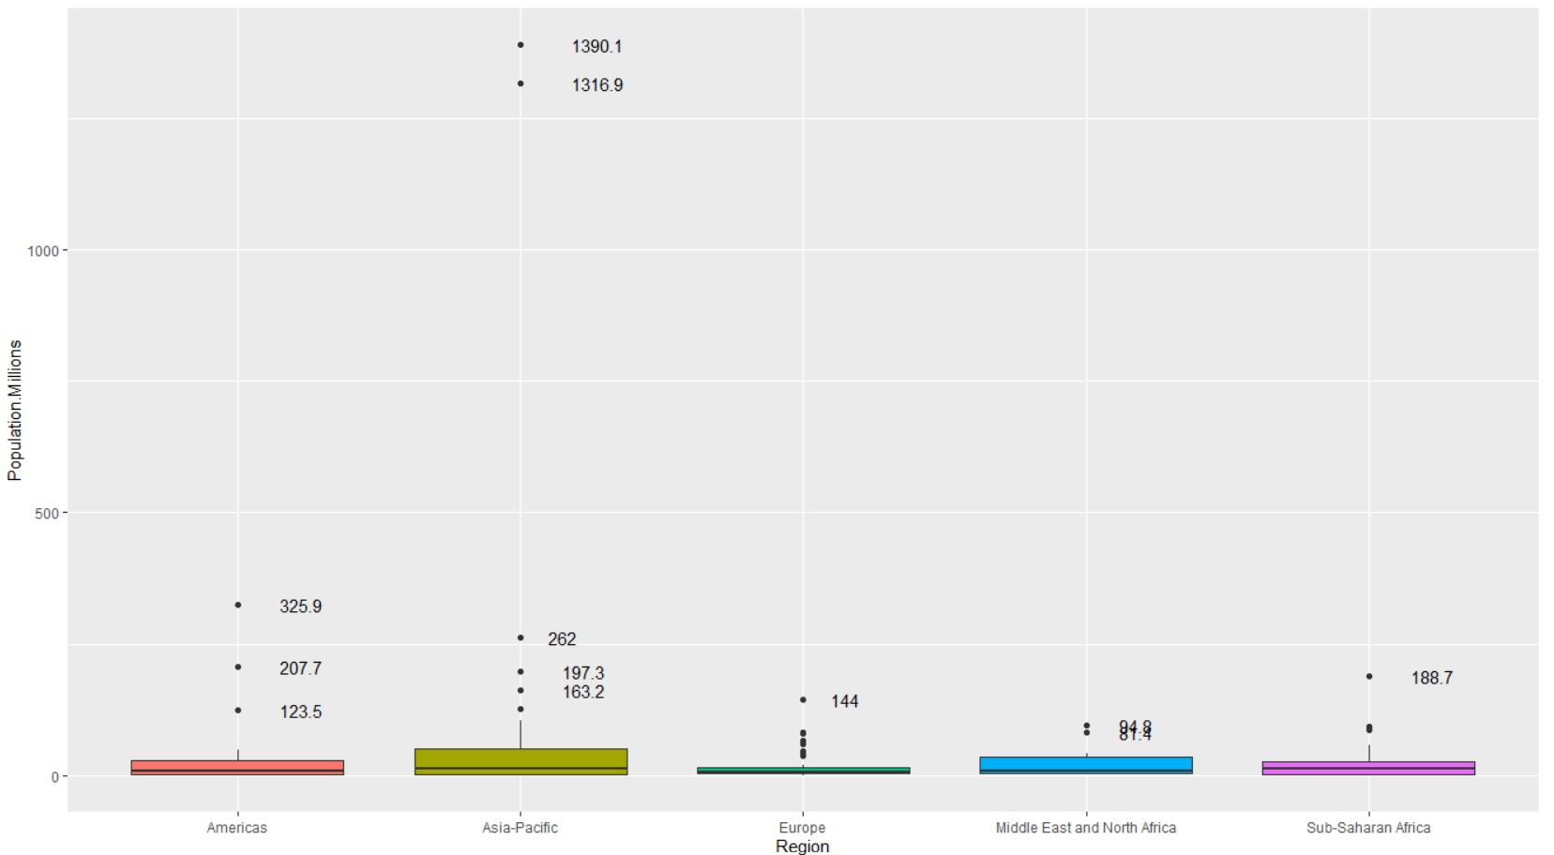
Population
World Population Distribution

Slide 6
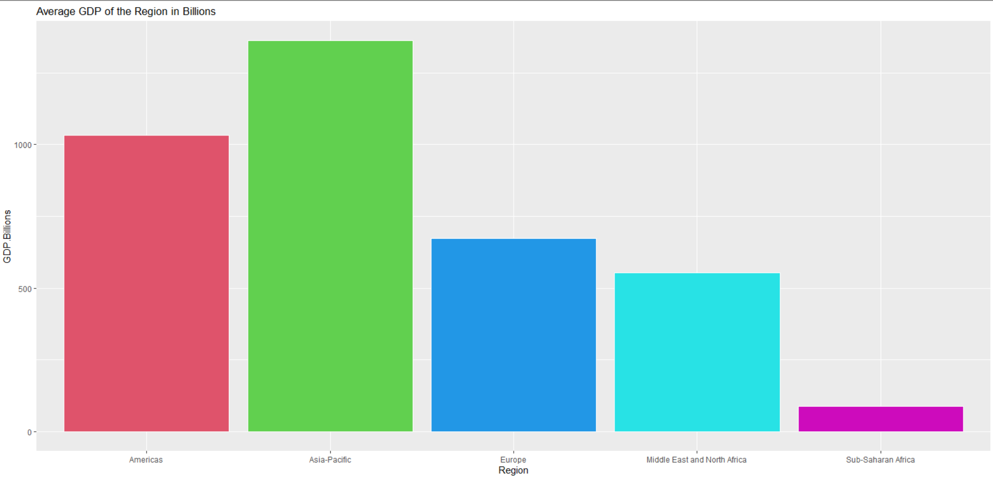
Gdp distribution
Average GDP barplot of different regions of the world
Americas - 30 countries
Asia-Pacific - 40 Countries
Europe - 43 Countries
ME & N.Africa- 14 Countries
SS Africa - 46 Countries

Slide 7
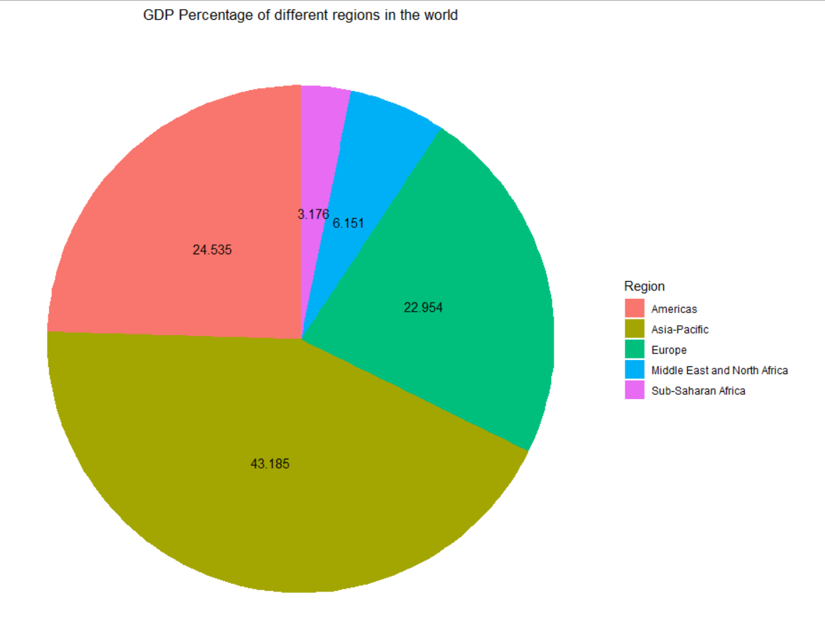
GDP Distribution
GDP percentage contribution by different regions of the world

Slide 8
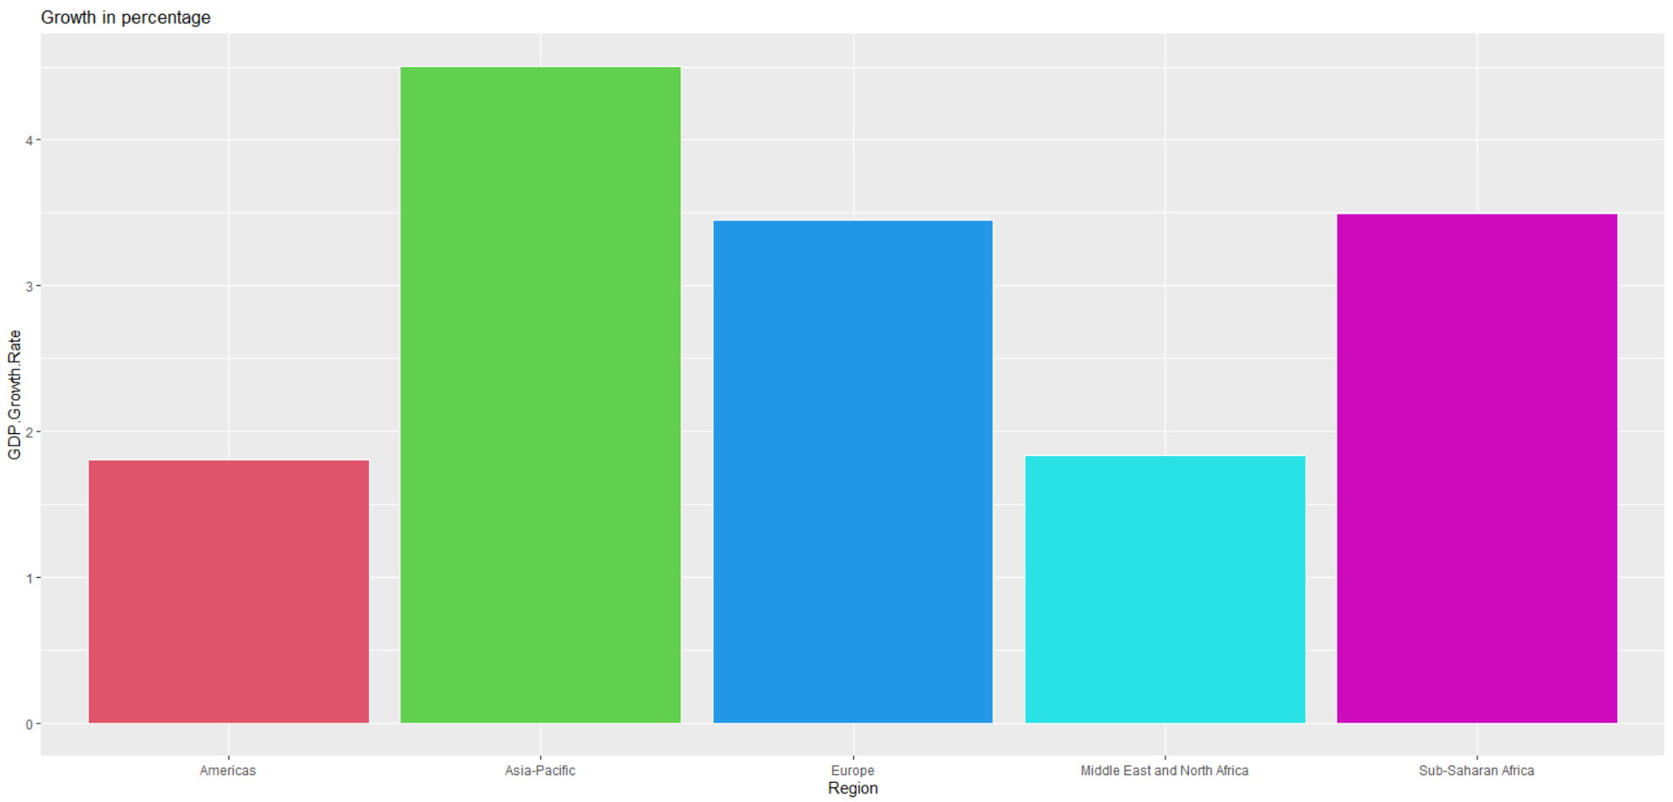
GDP growth
Mean GDP growth across different regions

Slide 9
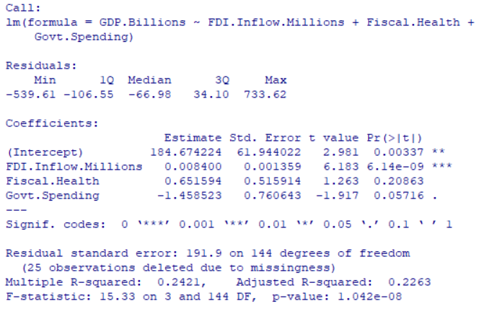
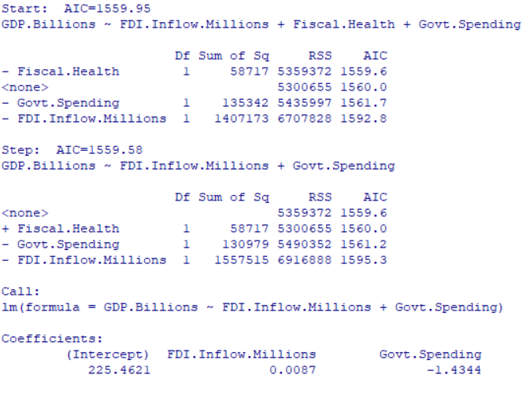
GDP Dependencies
GDP of a country has a direct dependency with the amount of Foreign Direct Investment

Slide 10
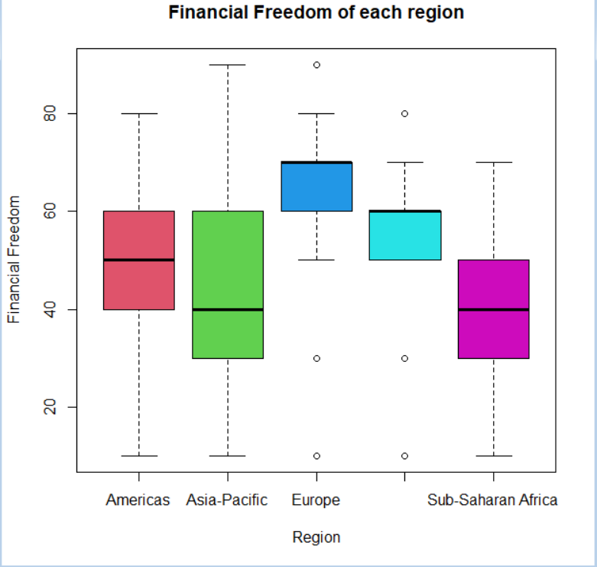
Financial Freedom of each region
Financial freedom usually means having enough savings, financial investments, and cash on hand to afford the kind of life we desire for ourselves and our families
This graph shows that Europe has more financial freedom where they are more likely to spend
Middle
East

Slide 11
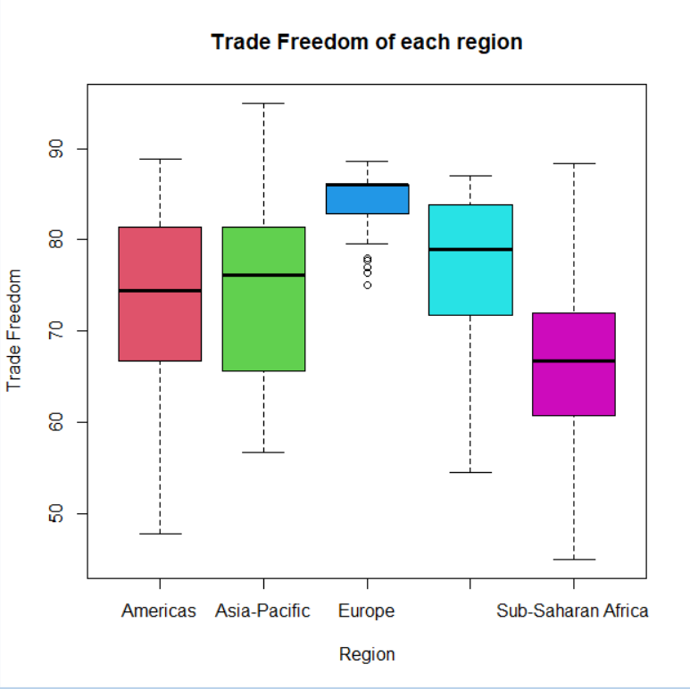
Trade Freedom of each region
Trade freedom is a composite measure of the extent of tariff and non-tariff barriers that affect imports and exports of goods and services.
Middle
East

Slide 12
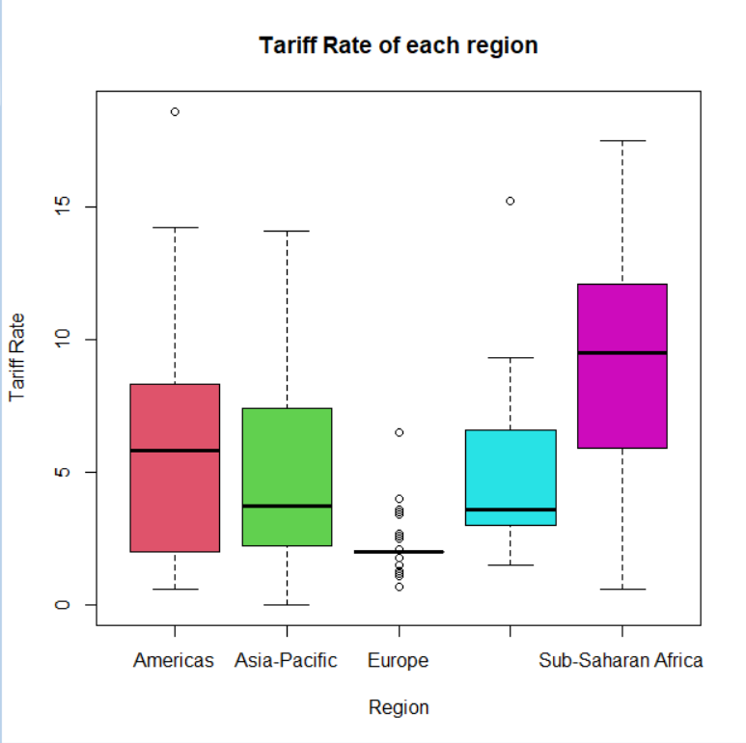
Tariff rate of each region
Increase in the prices of goods and services purchased from another country, making them less attractive to domestic consumers.
In this graph we can see that Europe does not conform to any fixed tariff mean based on region.
Middle
East

Slide 13
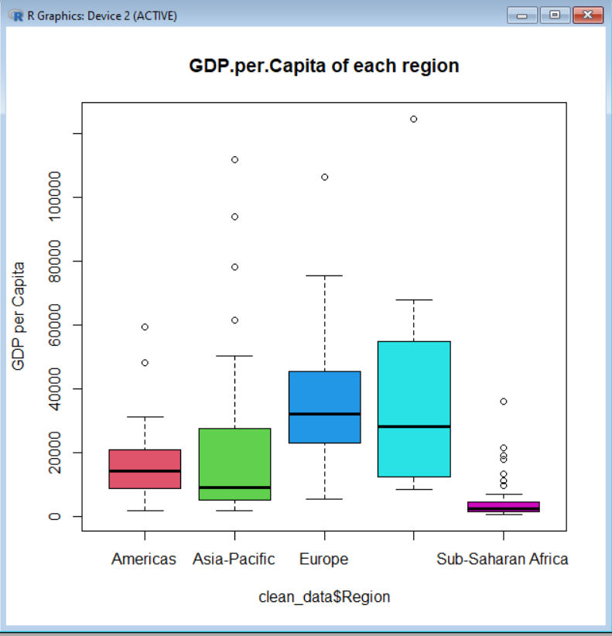
GDP per capita of each region
We can see good box plots for most of the region apart from Sub - Saharan Africa where its generally at the lower end showing poverty and subsequently lack of growth. Also we can see that Asia - Pacific is an upcoming market for the world.
Middle
East
Middle
East

Slide 14
GDP per capita Dependencies
Call:
lm(formula = GDP.per.Capita ~ Tariff.Rate + Financial.Freedom +
Trade.Freedom + Inflation)
Residuals:
Min 1Q Median 3Q Max
-29360 -11075 -2712 5715 91772
Coefficients:
Estimate Std. Error t value Pr(>|t|)
(Intercept) -104553.82 41417.04 -2.524 0.0125 *
Tariff.Rate 1448.98 1110.48 1.305 0.1937
Financial.Freedom 421.31 105.15 4.007 9.23e-05 ***
Trade.Freedom 1287.25 511.14 2.518 0.0127 *
Inflation 17.53 16.52 1.061 0.2903
---
Signif. codes: 0 ‘***’ 0.001 ‘**’ 0.01 ‘*’ 0.05 ‘.’ 0.1 ‘ ’ 1
Residual standard error: 17570 on 168 degrees of freedom
Multiple R-squared: 0.4166, Adjusted R-squared: 0.4027
F-statistic: 29.99 on 4 and 168 DF, p-value: < 2.2e-16
In this model we can see that the tariff rate and inflation are not significant variables in determining GDP per Capita of the countries. Thus, we can conclude that GDP per capita is dependent on the Trade Freedom and Financial Freedom. So, countries having more financial freedom and more trade freedom are more prosperous.

Slide 15
Tariff Rate Dependencies
Call:
lm(formula = Tariff.Rate ~ GDP.per.Capita + Financial.Freedom +
Trade.Freedom + Inflation)
Residuals:
Min 1Q Median 3Q Max
-3.1031 -0.8728 0.0305 0.7506 3.5466
Coefficients:
Estimate Std. Error t value Pr(>|t|)
(Intercept) 3.657e+01 7.409e-01 49.351 < 2e-16 ***
GDP.per.Capita 6.924e-06 5.306e-06 1.305 0.194
Financial.Freedom 4.087e-02 6.924e-03 5.902 1.93e-08 ***
Trade.Freedom -4.414e-01 1.166e-02 -37.851 < 2e-16 ***
Inflation -5.029e-04 1.145e-03 -0.439 0.661
---
Signif. codes: 0 ‘***’ 0.001 ‘**’ 0.01 ‘*’ 0.05 ‘.’ 0.1 ‘ ’ 1
Residual standard error: 1.215 on 168 degrees of freedom
Multiple R-squared: 0.9258, Adjusted R-squared: 0.924
F-statistic: 524.2 on 4 and 168 DF, p-value: < 2.2e-16
In this model we can see that the GDP per capita and inflation are not significant variables in determining Tariff Rate of the countries. Thus, we can conclude that Tariff Rate is dependent on the Trade Freedom and Financial Freedom. So, countries having more financial freedom and more trade freedom are more prosperous.

Slide 16
Inflation Dependencies
Call:
lm(formula = Inflation ~ Tariff.Rate + GDP.per.Capita + Financial.Freedom + Trade.Freedom)
Residuals:
Min 1Q Median 3Q Max
-45.60 -16.67 -5.32 6.64 1036.30
Coefficients:
Estimate Std. Error t value Pr(>|t|)
(Intercept) 1.605e+02 1.960e+02 0.819 0.414
Tariff.Rate -2.279e+00 5.191e+00 -0.439 0.661
GDP.per.Capita 3.796e-04 3.578e-04 1.061 0.290
Financial.Freedom -8.336e-01 5.081e-01 -1.641 0.103
Trade.Freedom -1.380e+00 2.421e+00 -0.570 0.569
Residual standard error: 81.79 on 168 degrees of freedom
Multiple R-squared: 0.04137, Adjusted R-squared: 0.01855
F-statistic: 1.813 on 4 and 168 DF, p-value: 0.1287
From this test we get a unique result that inflation in a country is not dependent on Tariff rate, GDP per Capita, Financial Freedom, Trade Freedom

Slide 17
Inflation Dependencies
Call:
lm(formula = Inflation ~ Business.Freedom + Public.Debt.of.GDP.)
Residuals:
Min 1Q Median 3Q Max
-48.43 -14.70 -4.96 5.71 1044.05
Coefficients:
Estimate Std. Error t value Pr(>|t|)
(Intercept) 80.31714 29.39834 2.732 0.00696 **
Business.Freedom -0.99040 0.42194 -2.347 0.02007 *
Public.Debt.of.GDP. -0.09434 0.18410 -0.512 0.60900
---
Signif. codes: 0 ‘***’ 0.001 ‘**’ 0.01 ‘*’ 0.05 ‘.’ 0.1 ‘ ’ 1
Residual standard error: 81.63 on 170 degrees of freedom
Multiple R-squared: 0.03359, Adjusted R-squared: 0.02222
F-statistic: 2.955 on 2 and 170 DF, p-value: 0.05478
In this model we can see that the Public.Debt.of.GDP is not significant variable in determining Inflation of the countries. Thus, we can conclude that Inflation is dependent on the Business Freedom. So, countries having more Business freedom are more prosperous.

Slide 18
Best Model for GDP per Capita
> stepAIC(model,direction="both")
GDP.per.Capita ~ Financial.Freedom + Trade.Freedom
Df Sum of Sq RSS AIC
<none> 5.2741e+10 3385.6
+ Tariff.Rate 1 504292609 5.2237e+10 3386.0
+ Inflation 1 326004320 5.2415e+10 3386.5
- Trade.Freedom 1 5062924043 5.7804e+10 3399.5
- Financial.Freedom 1 8126250117 6.0868e+10 3408.4
Call:
lm(formula = GDP.per.Capita ~ Financial.Freedom + Trade.Freedom)
Coefficients:
(Intercept) Financial.Freedom Trade.Freedom
-51097.2 472.6 651.9
This test conclusively proves that to calculate the GPD.per.Capita we require Financial Freedom and Trade Freedom only.

